Slide 1
无人
生还
There Were None
And Then
2019/01

Slide 2
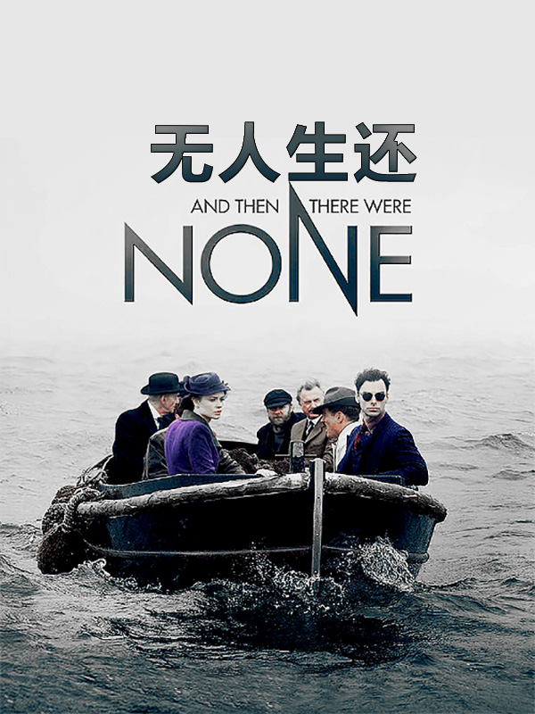
Name:《And Then There
Were None》
Author:Agatha Christie
Time:1939
Style:Suspense,Mystery

Slide 3
01.
Author Introduction
02.
The Content Introduction
Contents
03.
The End

Slide 4
01.
Author Introduction
PART 1

Slide 5
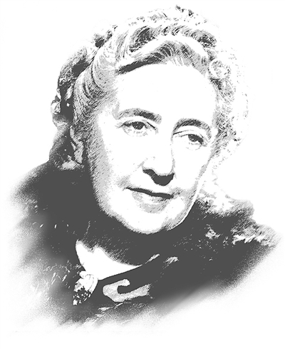
Agatha Christie
British mystery writer whose books are second only to those of Shakespeare.
Her first novel, the strange case of styles, was written at the end of world war I, served as a volunteer ambulance. In this novel, she created a cute little Belgian detective, hercule pogue, who became the most popular detective in detective novels after Sherlock Holmes. In 1926, Agatha Christie wrote her famous book the Roger mystery. In 1952, her most famous play, the mousetrap, was put on the stage. Since then, it has been performed continuously for a long time, setting a record in the history of world theater.

Slide 6
02.
The Content Introduction
PART 2

Slide 7
Eight of the guests and two of the servants had received invitations scrawled in roughly the same text and signed in illegible letters. Then a series of suspense ensues as bloor heads for the island......

Slide 8
The old man who foretold "the day of judgment is near";
The nursery rhymes about ten soldiers in the villa rooms;
Ten small porcelain figures on the table;
Recording of alleged crimes during the guests' first evening meal;
Brent read a passage from the bible

Slide 9
Ten strangers were invited to a private mansion on Indian island by the wealthy Mr. Owen. After dinner, a mysterious voice revealed the terrible secrets hidden by each person. That night, the young Mr. Marston died mysteriously, the old nursery rhyme like a curse to cover all the people, there seems to be a pair of mysterious glasses in the moment to look at the game of death, visitors like the disappeared Indian small porcelain man one after another towards death...

Slide 10
Mr. Justice Lawrence John Wargrave
The judge, sentenced Edward seton to death
Vera Elizabeth Claythorne
The teacher, murdered Cyril ogilvy Hamilton
The captain, found guilty of causing the deaths of 21 men from an east African tribe
Captain Philip Lombard
Emily Caroline Brent
The nun, take full responsibility for beatrice Taylor's death
The general, deliberately murdered his wife's lover, Arthur Richmond
General John Gordon Macarthur
Anthony James Marston
The dude, killed John and Lucy coombs
William Henry Blore
The detective, led to the death of James Stephen landau
Thomas Rogers and Ethel Rogers
The housekeepers, killed Jennifer brady
Edward George Armstrong
The doctor, killed one patient by surgery after drinking too much

Slide 11
Metaphors
U·N·0 is a name full of Christian meaning, which represents an unknown number. Seemingly mischievous murder case insinuates the fact that innocent people are wronged and sinners are not punished in real life, and endows a profound connotation of judgment.

Slide 12
Personality and values
On the same subject the reader sees the dignity and obstinacy of miss brent, the romance and fear of vera, the sophistication of walgrave, the cynicism of Lombard, the wariness of Armstrong, and Rogers' almost obsessive pursuit of order.

Slide 13
03.
The End
PART 3

Slide 14
Through characterization, Agatha, on the one hand, reveals the true face of human greed, selfishness and guilt, and reflects the reality that victims are suffering from injustice and have no place to appeal, thus fulfilling the literary mission of "literature reflects life" and "literature is human studies". On the other hand, it also expresses the realistic appeal for the harmonious development of ethics and law, and practices the social function of "literature purifying the soul". In these two senses, her works are not only popular, but also serious and full of social connotation.

Slide 15
Thanks for watching.

